Slide 1
Nature and Scope of Economics
Professor & Lawyer
Puttu Guru Prasad
VVIT- Nambur
puttuguru.blogspot.in
93 94 96 98 98
9885 96 36 36

Slide 2
Introduction
The word Economics is derived from the Greek word “OKIOS NEMEIN” meaning household management
Man is a bundle of desires. Goods and services satisfy these wants. But almost all the goods are scares
To produce goods factors of production are needed and these are all scarce

Slide 3
The Study of Economics
Economics is the study of how individuals and societies choose to use the scarce resources that nature and previous generations have provided.
It is the study of economic problems. Wants are motive for economic activity. Wants leads to efforts and which lead to satisfaction

Slide 4
Why Study Economics?
To learn a way of thinking
Three fundamental concepts:
  Opportunity cost
  Marginalism, and
  Efficient markets

Slide 5
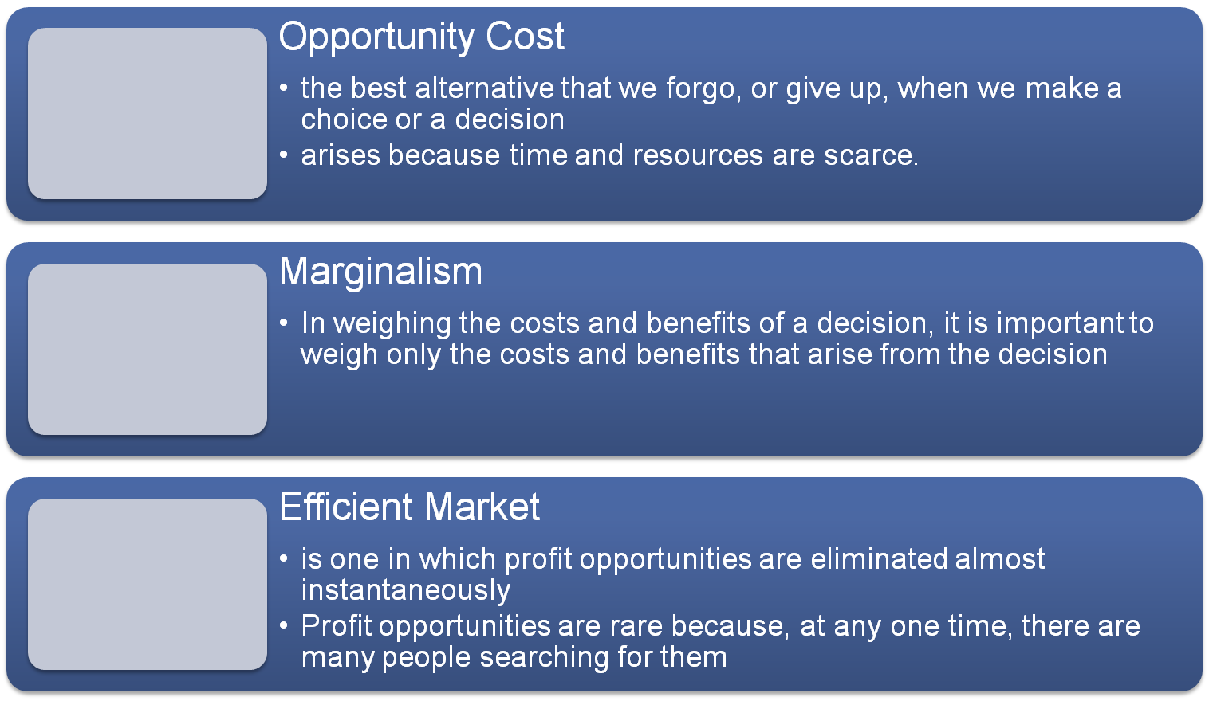
Contd…

Slide 6
Economic Definitions
Adam Smith gave the Wealth Definition
Alfred Marshall gave the Welfare Definition
Lionel Ribbons gave the Scarcity Definition
Paul Samuelson gave the Growth Definition

Slide 7
Wealth Definition
Adam Smith (Father of Economics) in his book “Wealth of nations 1776” defined economics is the study of wealth
J.B. Jay, J.S. Mill, Walker, B Price all agreed with Adam Smith
In this definition wealth is given the first place and man is given the second place

Slide 8
Meaning of wealth
Around the industrial revolution, merchants were the most powerful class in Western Europe, and wealth for them meant money only. Since money at that time was in the shape of gold, merchants declared gold as the only wealth,
This definition rendered merchants as the only productive class, as they created it by trade,
This definition harmed the interests of newly emerging class of petty industrialists and their hard working workers,
Adam Smith as spokesman of the emerging class widened the definition to include all material goods,
Activities which did not result in material goods production were unproductive.

Slide 9
Causes of wealth of nations: Capitalism
Traders were not the only cause of wealth,
Freedom of trade and enterprise were the greatest causes of wealth because:
Human beings are born selfish
They have self interest,
It is not the benevolence but self interest which guides economic activity
So left to themselves, each individual would maximise his self interest (income/wealth),
When all the adult citizens of a nation maximise their self interest, the wealth of nation would grow the fastest,
So why should the mercantilists or anybody else impose restriction on the freedom of individuals,

Slide 10
Exceptions (Criticism)
While an invisible hand guides societies which rely on self interest, there are certain exceptions where it does not work. These are:
Defense
Public utilities
Law order and justice

Slide 11
Science of welfare
Adam Smith’s prophesy that self interest would be beneficial to all did not materialise after the industrial revolution,
The revolution divided the society between haves and have-nots, including unemployd
Criticism turned reformist and revolutionary,
Marshall attempted to offer a compromise and a new definition:
“ Political economy or economics is the study of mankind in the ordinary business of life; it examines that part of individual and social action which is most closely connected with the attainment and with the use of the material requisites of well-being”.
“ The range of our enquiry becomes restricted to that part of social welfare which can be brought directly or indirectly into relashhionship with measuring rod of money”, Pigou.

Slide 12
Criticism of welfare definition
Economics is not restricted to material things, non material things like health and education, entertainment are also important,
Welfare is subjective and varies from person to person,
It is difficult to segregate material welfare from other types of welfare,
The concept of welfare is not fixed but subject to change and interpretation,
It differs from time to time, country to country

Slide 13
Science of scarcity
According to Lionel Ribbons Economics is “the science which studies human behavior as a relationship between ends and scarce means which have alternative uses”. So all goods and services commanding a price fall under the scope of economics.
Unlimited human wants: Necessities, comforts and luxuries’
Necessities:
Necessities of existence
Necessities of efficiency, and
Necessities of convention.

Slide 14
Contd…
Comforts and luxuries are :
A) Related to time, place
B) No watertight compartmentalization as a luxury may be comfort or even a necessity for someone or at different periods of history.
Criticism;
It fails to explain why labour despite being scarce remains unemployed / underemployed
It also fails to explain situations of abundance
Is neutral to ends
Ignores welfare

Slide 15
Science of growth and development
“Economics is the study of how men and society chose, with or without the use of money, to employ scarce productive resources which could have alternative uses, to produce various commodities over time and distribute them for consumption now and in future amongst various people and groups of society”

Slide 16
The Scope of Economics
Microeconomics is the branch of economics that examines the functioning of individual industries and the behavior of individual decision-making units—that is, business firms and households.
Macroeconomics is the branch of economics that examines the economic behavior of aggregates— income, output, employment, and so on—on a national scale

Slide 17
The Diverse Fields of Economics
Examples of microeconomic and macroeconomic concerns
 | Production | Prices | Income | Employment
Microeconomics | Production/Output in Individual Industries and Businesses How much steel How many offices How many cars | Price of Individual Goods and Services Price of medical care Price of gasoline Food prices Apartment rents | Distribution of Income and Wealth Wages in the auto industry Minimum wages Executive salaries Poverty | Employment by Individual Businesses & Industries Jobs in the steel industry Number of employees in a firm
Macroeconomics | National Production/Output Total Industrial Output Gross Domestic Product Growth of Output | Aggregate Price Level Consumer prices Producer Prices Rate of Inflation | National Income Total wages and salaries Total corporate profits | Employment and Unemployment in the Economy Total number of jobs Unemployment rate

Slide 18
The Method of Economics
Positive economics studies economic behavior without making judgments. It describes what exists and how it works.
Normative economics, also called policy economics, analyzes outcomes of economic behavior, evaluates them as good or bad, and may prescribe courses of action.

Slide 19
Contd…
Positive economics includes:
  Descriptive economics, which involves the compilation of data that describe phenomena and facts.
  Economic theory, which involves building models of behavior.
    An economic theory is a general statement of cause and effect, action and reaction

Slide 20
Contd…
Empirical economics refers to the collection and use of data to test economic theories.
Many data sets are available to facilitate economic research. They are collected by both government agencies and private companies,

Slide 21
Criteria for judging economic outcomes
Economic growth, or an increase in the total output of an economy.
Economic stability, or the condition in which output is steady or growing, with low inflation and full employment of resources.
Efficiency, or allocative efficiency. An efficient economy is one that produces what people want at the least possible cost
Equity, or fairness of economic outcomes

Slide 22
Economic System
The manner or the structure through which the economy of a country operates is known as Economic System
Variety of Economic Systems
They differ from each other not only in details but also in broader outlines
Types of Economic Systems:
  Capitalist
  Socialist and
  Mixed Economy

Slide 23
Capitalism
All economic activities are guided by market forces
Policy of laiseez-faire (absence of state intervention). Privately owned resources
What to Produce, how to produce and for whom to produce power rests with the producers
Profit maximization is the main aim

Slide 24
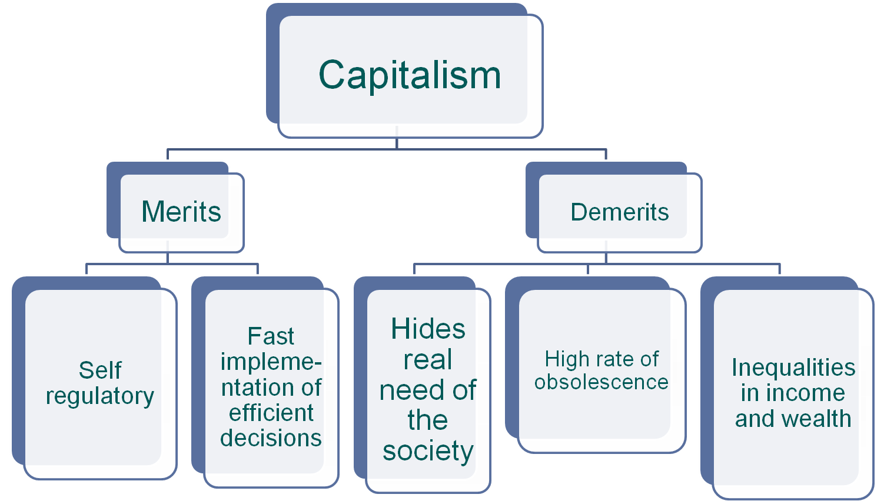
Merits and Demerits

Slide 25
Socialism
Originated due to drawbacks of capitalism
Just opposite to capitalism
The merits of capitalism become the demerits and merits thus become the demerits
It aims at removing the inequalities of income and wealth, inequalities of economic opportunities, unemployment and waste of productive resources

Slide 26
Mixed Economy
Merits of capitalism and Socialism are taken and a Mixed economy is formed
Generally adopted by countries with low per capita income and is underdeveloped or is developing (India)
Some sectors are kept in Government control
Arihant Jain P.G.D.M.

Slide 27

Arihant Jain P.G.D.M.

